Slide 1
STRATEGIC PLAN
FIRM 2

Slide 2
Agenda
Current Situation
Overall Strategy
Product 1 Strategy
Product 2 Strategy
Financial Strategy

Slide 3
Current Situation

Slide 4
The world watch market is spread across 6 countries with differing consumer preferences
5 Companies compete in each market
Two products are offered by each company
Each market has different factors impacting production
 | China | Germany | Japan | Mexico | UK | US
Fixed Costs | Low | High | High | Low | Mid | Mid
Variable Costs | High | Low | Low | High | Mid | Mid
Construction Costs | Low | High | High | Low | Mid | Mid
R&D Impact | Low | High | High | Low | Mid | Mid

Slide 5
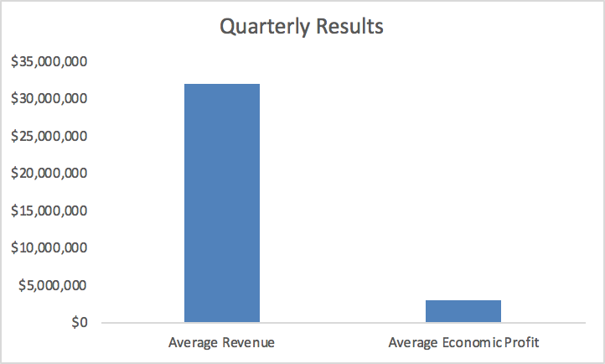
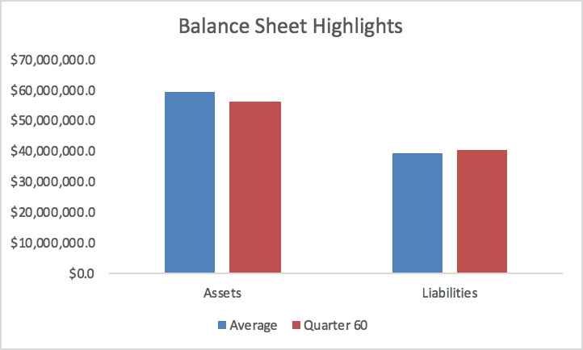
Firm 2, is a key player in the global watch industry
5 years of market excellence
Large cash reserves
Analytical expertise

Slide 6
Analytical Approach

Slide 7
Multivariate regressions were run to properly plan the business strategy
A linear model was fit to each country/product combination based on the following factors:
Relative Price
Relative Quality
Absolute Green Value
3 lag periods
Marketing spend
To measure a response in terms of market share.
Relative Price and Relative Quality
Market Share
Marketing Spend
Absolute Green Value

Slide 8
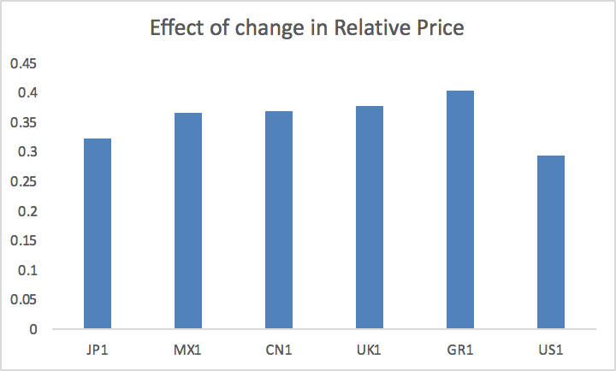
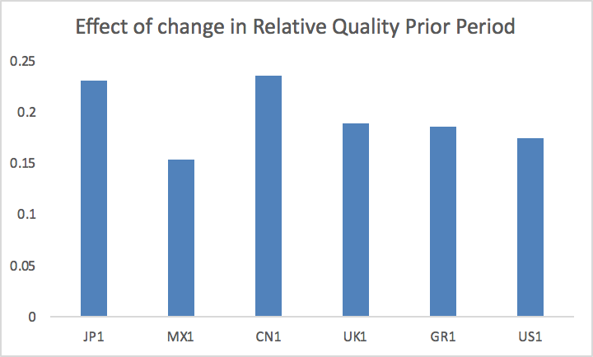
For product 1, relative price has a relatively similar impact on market share in all countries, while China and Japan are most sensitive to quality
Absolute value of coefficient on Relative Price

Slide 9
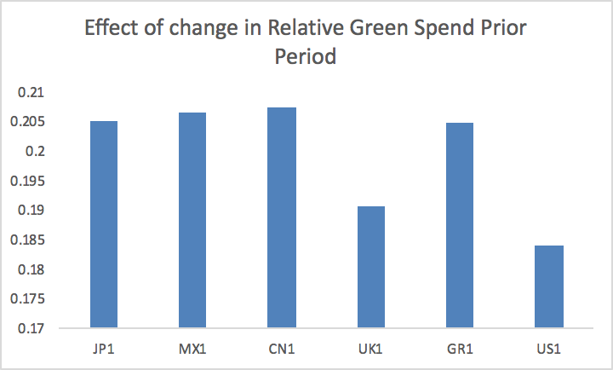
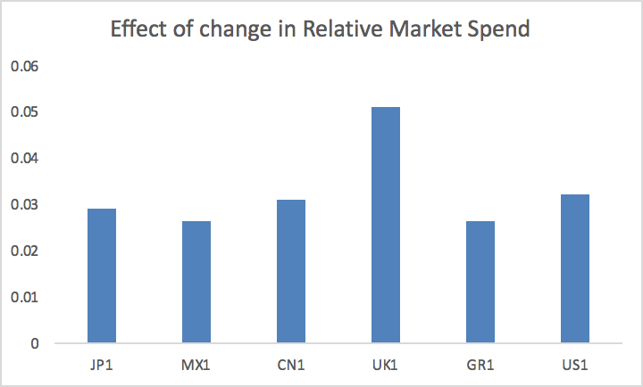
Green value has the most significant impact in Japan, Mexico and China for Product 1, while relative market spend is most significant in the UK
Absolute value of coefficient on Relative Price

Slide 10
Relative Market Share Response to Control Factors - Product 1
Factor\Country | Japan | Mexico | China | UK | Germany | US
Relative Price | Low | Low | Low | High | Low | Med
Relative Quality | High | Low | Low | Low | Low | Low
Green Spend | Med | Low | Low | High | High | Low
Market Spend | Low | Low | Low | High | Low | Low

Slide 11
Country Profiles - Product 1
Japan
Mildly sensitive to price
Preferes the best quality
Looking for green products
Difficult to get new cust through marketing spend
Mexico
Sensitive to quality
Looking for green products
Difficult to get new cust through marketing spend
China
Most price sensitive
Not affected by quality
Impartial to green products
Last in sales
UK
Cares about relative price
Not so concerned with quality
Looking for a green product
Possible to get additional cust. form marketing
Germany
Mildly sensitive to price
Looking for greenest products
Difficult to get new cust through marketing spend
US
2nd most price sensitive
Impartial to green products
1st in sales

Slide 12
Country Profiles - Product 1 Regression Analysis
Japan Product 1
- higher relative price decreases market share
- increase in market leads to increase in market share
- marketing spend is significant for 3 lag periods
- relative quality is key for lag period 1
- green spend is key for lag period 1
Mexico Product 1
- higher relative price decreases market share
- increase in market leads to increase in market share
- marketing spend is significant for 2 lag periods
- relative quality is key for lag period 1
- green spend is key for lag period 1
China Product 1
- higher relative price decreases market share
- higher relative quality increases market share
- increase in market leads to increase in market share
- marketing spend is significant for 2 lag periods
- relative quality is key for lag period 1
- green spend is key for lag period 1
UK Product 1
- higher relative price decreases market share
- increase in market leads to increase in market share
- marketing spend is significant for 2 lag periods
- relative quality is key for lag period 1
- green spend is key for lag period 1

Slide 13
Country Profiles - Product 1 Regression Analysis
Germany Product 1
- higher relative price decreases market share
- increase in market leads to increase in market share
- marketing spend is significant for 2 lag periods
- relative quality is key for lag period 1
- green spend is key for lag period 1
US Product 1
- higher relative price decreases market share
- increase in market leads to increase in market share
- marketing spend is significant for 3 lag periods
- relative quality is key for lag period 1
- green spend is key for lag period 1 and again for lag period 3

Slide 14
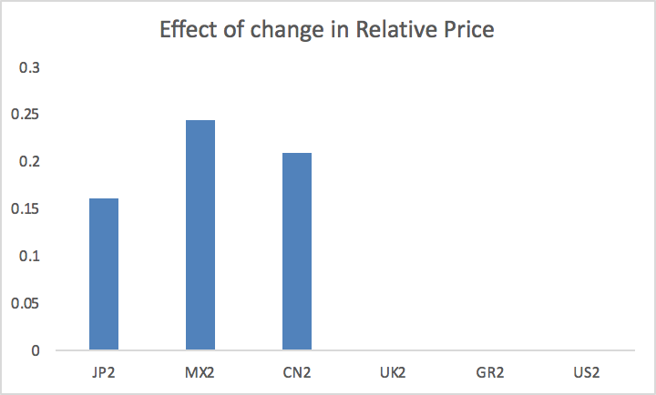
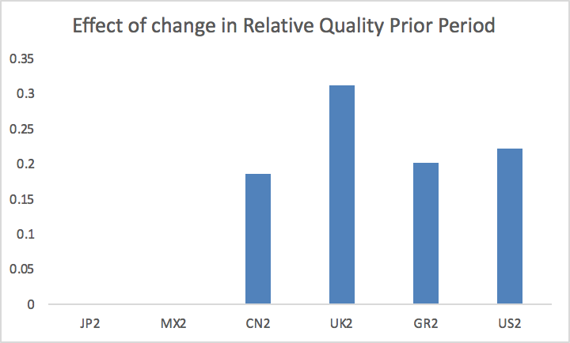
Only Japan, Mexico and China are sensitive to price changes for product 2, while relative quality has the highest impact in the UK
Absolute value of coefficient on Relative Price

Slide 15
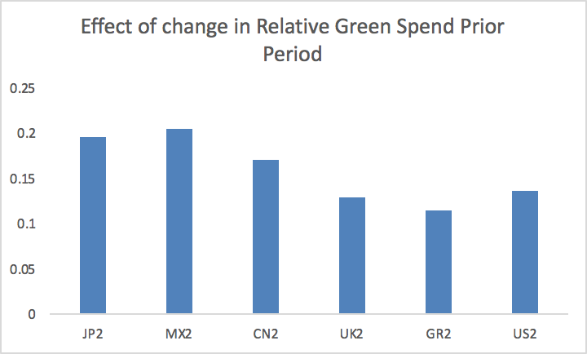
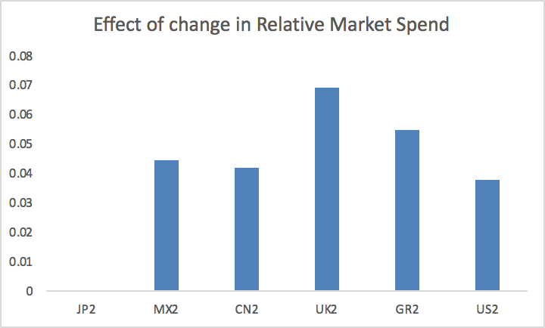
For product 2, the impact of green spend is highest in Japan and Mexico, while marketing spend is best used in UK and Germany
Absolute value of coefficient on Relative Price

Slide 16
Relative Market Share Response to Control Factors - Product 2
Factor\Country | Japan | Mexico | China | UK | Germany | US
Relative Price | Low | High | Med | Med | Low | Low
Relative Quality | Med | Low | Low | Low | High | Med
Green Spend | Med | Med | Low | High | High | High
Market Spend | Low | High | Med | Low | Low | Low

Slide 17
Country Profiles - Product 2
Japan
Mildly sensitive to price
Prefers better than average quality
Looking for green products
2nd in sales
Mexico
Preferes the cheapest product
Not affected by quality
Looking for green products
Easy to get cust. w/increase market spend
China
Prefers cheaper than avg product
Not affected by quality
Impartial to green products
Somewhat easy to get cust. w/increase market spend
Last in sales
UK
Cares about relative price
Not so concerned with quality
Looking for the greenest product
Possible to get additional cust. form marketing
Germany
Somewhat sensitive to price
Preferes the best quality
Looking for green products
Difficult to get new cust through marketing spend
3rd in sales
US
Price sensitive
Quality sensitive
Looking for green products
Difficult to get new cust through marketing spend
1st in sales

Slide 18
Country Profiles - Product 1 Regression Analysis
Japan Product 2
- higher relative price decreases market share
- relative quality matters
- marketing spend is significant for lag period 2
- green spend is key for lag period 1
Mexico Product 2
- higher relative price decreases market share
- relative quality matters
- marketing spend increases market share
- marketing spend is significant for 2 lag periods
- green spend is key for lag period 1 and 3
China Product 2
- higher relative price decreases market share
- relative quality matters 1 lag period out
- marketing spend increases market share
- marketing spend is significant for 2 lag periods
- green spend is key for lag period 1
UK Product 2
- price insensitive
- relative quality matters in one lag period
- marketing spend increases market share for current period only
- green spend is key for lag period 1

Slide 19
Country Profiles - Product 1 Regression Analysis
Germany Product 2
- price insensitive
- relative quality matters in one lag period
- marketing spend increases market share for current period only
- green spend is key for lag period 1
US Product 2
- price insensitive
- relative quality matters in one lag period
- marketing spend increases market share for current period only
- green spend is key for lag period 1

Slide 20
General Strategy

Slide 21
Overall Approach
Focus on features that have the most impact for a given product and country
Maximize efficiency of marketing, green, and quality spend dollars as well as their latency effects in conjunction with corresponding price changes to capture the highest market share possible.
Lower costs
Aim for an inventory level of 15-25% of total demand
Reduce chances of stockout by optimizing factory dollars spent on production and construction.
Collect Receivables
Pay down debt
Reduce WACC
Fund continuous product improvement
Marketing Strategy
Operations Strategy
Finance Strategy

Slide 22
Product 1 Strategy and Positioning

Slide 23
Product 1 Strategy
The market for Product 1 is highly elastic.
Pricing should be competitive while still aiming to maintain a contribution margin percentage of ~25-40%.
In order to maximize our marketing dollars spent for product one, we will aim to increase quality spend and green spend at a conservative rate over time and aim for the following targets:
Relative Quality 105-110%
Relative Green Value 110-115%
Marketing focus will be on the countries that have the best marketing memory:
Japan and US 3 periods
All other markets are 2 periods

Slide 24
Product 1 Goals and KPIs
Maintain contribution margin percentages of ~20-40% for all countries.
Maintain a year end market share of greater than 20% for all countries.
Maintain a lead on green value in the range of 10-15%
Maintain a lead on quality in the range of 5-10%
Maintain an inventory level of 15-25% of current demand to avoid stock outs.

Slide 25
Product 2 Strategy and Positioning

Slide 26
Product 2 Strategy
The market for Product 2 relatively inelastic.
Pricing should be competitive while still aiming to maintain a contribution margin percentage of ~25-40%.
In order to maximize our marketing dollars spent for product one, we will aim to increase quality spend and green spend at a conservative rate over time and aim for the following targets:
Relative Quality 110-125%
Relative Green Value 110-115%
Marketing focus will be on the countries that have high importance on the last period’s quality spend.
US, Germany, and UK
China and Mexico should be easy to acquire customers through marketing spend if needed.
We will also ensure we up production value to keep demand satisfied.

Slide 27
Product 2 Goals and KPIs
Maintain contribution margin percentages of ~20-40% for all countries.
Maintain a year end market share of greater than 20% for all countries.
Maintain a lead on green value in the range of 10-15%
Maintain a lead on quality in the range of 10-25%
Maintain an inventory level of 15-25% of current demand to avoid stock outs.

Slide 28
Contract Market Strategy
Our goal will be to make low risk high reward bids.
If we are looking for quick cash we can pursue contracts more aggressively
Over the long run we will aim to corner the market on quality and by doing so, have the capability to secure contracts over our competitors.
If the there is a tie in terms of quality, we will cede the bidding war to the competitor if the bid would not secure us a better margin then we would have gotten at market.
Due to the inherent volatility of the contracts market, we will choose to expend time and effort on operations, marketing, and finance.

Slide 29
Overall Goals
Market goals
Maintain market share for all products above 20%
Maintain contribution margin percentages of ~20-40% for all countries
Maintain a minimum lead on relative quality and green spend of 5% each for both products for every period.
Reach a min absolute value of 80% green by year end for both products.
Reach a minimum absolute quality for P1 of 72% and P2 of 90%

Slide 30
Financial Strategy

Slide 31
Financial Strategy and KPIs
By paying down debt and focusing on projects with projected ROIC greater than WACC we will achieve financial success
Dividends will be cut to pay down debt and reduce WACC
Collection spending will be implemented to better collect on receivables
KPI | Current | Target | Change | Deadline
WACC | 11% | 9% | -18% | Year end
Debt to Equity | 1.89 | 1 | -47% | Year end
ROIC | 37.29% | 45% | 20.6% | Year end
Economic Profit | $3,049,291 | $4,000,000 | 33% | Year end

Slide 32
Competitor Intelligence

Slide 33
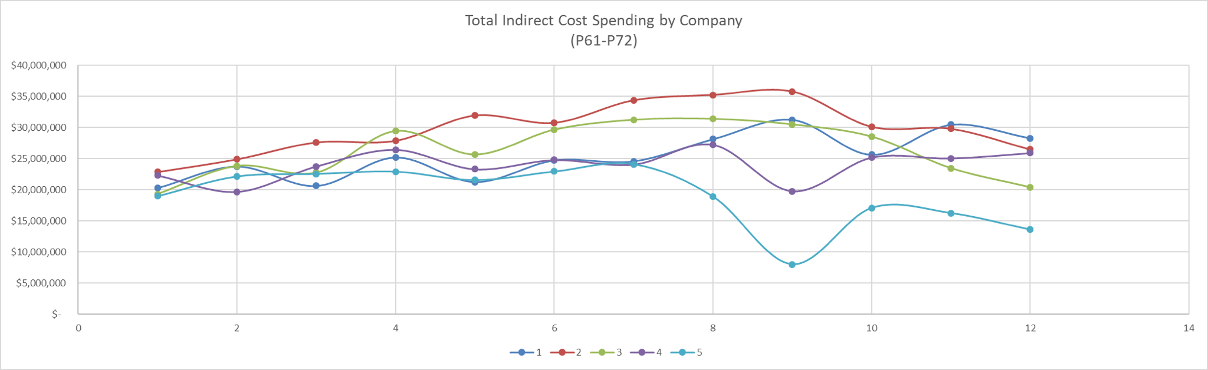
Competitor Intelligence Approach and Tools - Aim is to study Variable costs and Variable cost per Unit over time to minimize operational costs.
Hhhhh

Slide 34
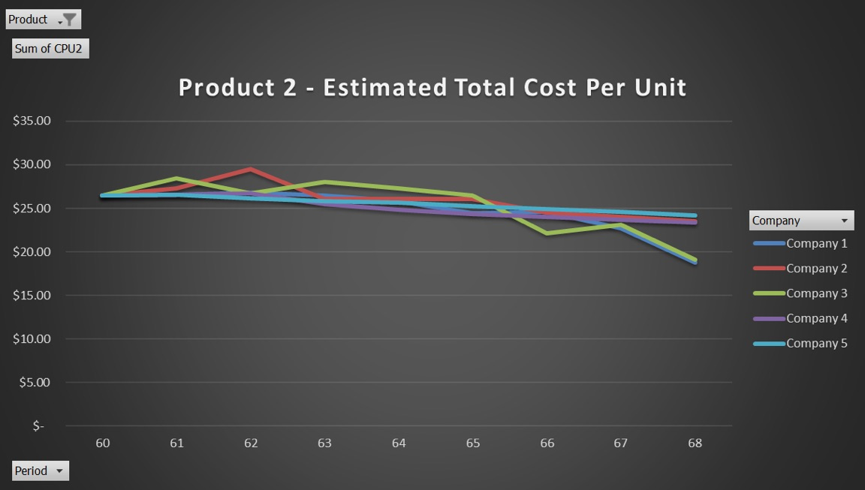
Competitor projections will help
Monitor Variable cost per unit and Variable cost projections of other firms to understand motives.
If other firms mimic our strategy then we would counteract by
Better inventory management - such as offloading inventory at lower prices
Moving factories to low cost locations
Optimizing inventory management

Slide 35
Business Risks

Slide 36
Firm 2 - SWOT Analysis
Strengths Analytics Large Cash Reserves Except Japan, Variable costs are lower in all other countries | Opportunities Improve operations Improve market share Lower debt
Weaknesses High WACC High bad debt expenses | Threats Competitors Macroeconomic events

Slide 37
Operational Challenges
Hitting positioning targets will be difficult due to relative nature
Preventing stock outs will be necessary to keep costs low
Maintaining adequate funding of factories
Maintaining adequate construction levels for factories to match capacity to demand.
Speed of adaptation to our competitors strategies to maintain our KPI goals.
Preparation and positioning for Macro events.
Knowing the right time to move a factory, if at all.
Forecasting unit sales and demand in light of new macro events in order to avoid stockout.

Slide 38
Financial Risks
Avoiding insurance could be risky
Paying down debt on too aggressive of a schedule could leave thin cash reserves
Reducing debt also reduces the tax benefit of interest payments, unclear what the optimal capital structure is
Currency fluctuations
We will likely stay out of the currency market, which could expose us to risk

Slide 39
Appendix

Slide 40
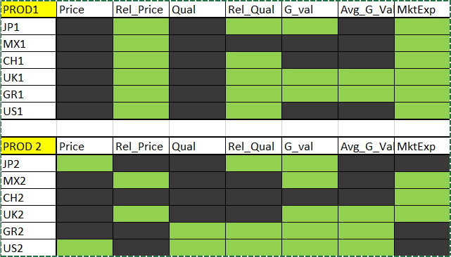
Understanding our customer preferences

Slide 41
CUSTOMER PROFILING
Customer response functions addressed for Product 1 and Product 2 by reading minimum, maximum and average of
Relative Price
Green Value
Relative Quality
Simple linear Model with Market share as the dependent variable for Product 1 and Product 2 was performed to understand the response to market spending.
Product 1 - Price sensitive product responded best to increased green value spending and relative quality in Japan, UK and Germany.
Product 2 - Price insensitive product also responded best to increased green value spending and relative quality in US, Japan and Germany.

Slide 42
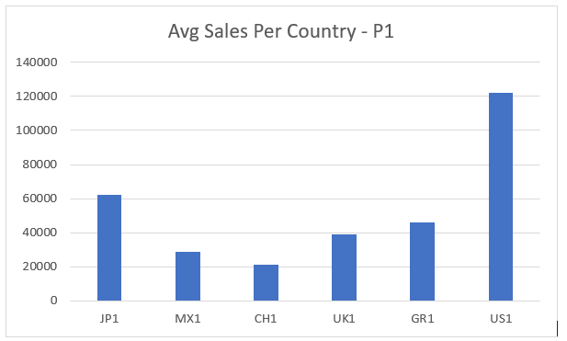
Customer Profile w/respect to Market Share Product 1 - cont.
(all values derived from the inverse of comparative p-statistics [y-axis])

Slide 43
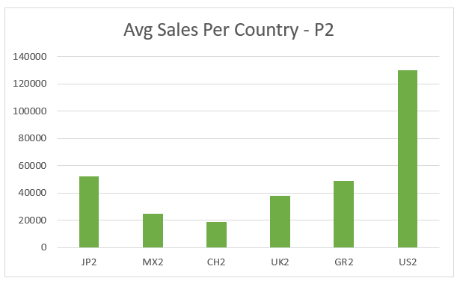
Customer Profile w/respect to Market Share Product 2 - cont.
(all values derived from the inverse of comparative p-statistics [y-axis])

